Slide 1

教学辅助课件
牛津 七年级下

Slide 2
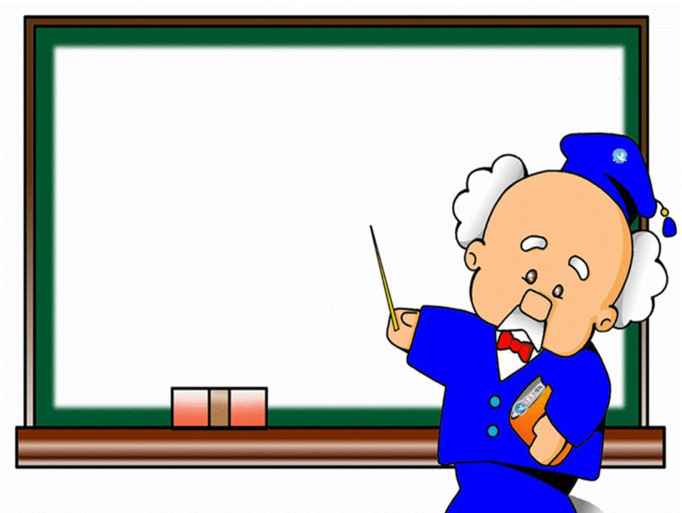
Unit 6
Grammar
Simple past tense (II)

Slide 3



New word and expression
put up
tent
搭，竖立
n. 帐篷

Slide 4


Objectives
To learn to use the simple past tense to make positive and negative sentences
To learn to use the simple past tense to ask and answer questions
To learn the new words and expressions: tent, at home, put up, the camping trip

Slide 5
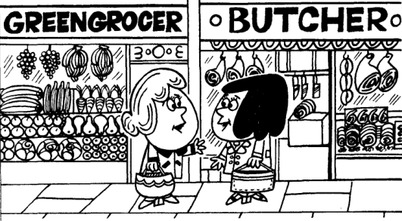
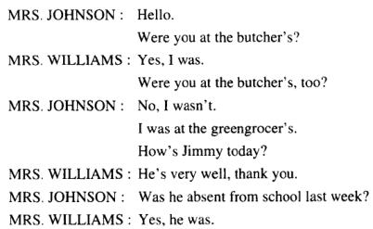
含有be动词的一般过去时的一般疑问句：
结构：_________ + ______ + ______
回答: (1) 肯定:___________________
(2) 否定:___________________
新概念英语1
Lesson 67 The weekend
Situation 1
Was/Were
主语
其他
Yes, 主语+was/were.
No, 主语+wasn’t/weren’t.
was not = wasn’t
were not = weren’t

Slide 6
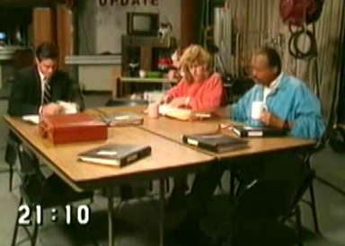

Situation 2
Watch a video and fill in the blanks.
A: What ___ you ___ on the weekend, Carol?
B: I _____ at home and _______ the house.
A: ___ you ______TV on Saturday night?
B: No, why?
A: I _______ a great movie.
did
do
stayed
cleaned
Did
watch
watched

Slide 7
A: What did you do on the weekend, Carol?
B: I stayed at home and cleaned the house.
A: Did you watch TV on Saturday night?
B: No, why?
A: I watched a great movie.
did not = didn’t
否定回答为:
No, I didn’t.
此处省略“I didn’t.”
一般过去时，含有行为动词的疑问句式
(1)一般疑问句:
__________+_____+_____________
(2)特殊疑问句: _______+____+_____+_____________
助动词did
主语
行为动词原形
疑问词
did
主语
行为动词原形
what, which, where, who, how, why

Slide 8



1. — Were you at butcher's, too?
— No, I wasn't. (新概念1 L67)
2. — Was he absent from school last week?
— Yes, he was. (新概念1 L67)
3. He did not understand English!
(新概念1 L73)
4. The English and Maths papers weren't
easy enough for me. (新概念1 L103)
5. Did you want to see me? (新概念1 L105)

Slide 9
Sentences from this unit:
1. One sunny day, Alice sat by a river
with her sister.
2. She looked up and saw a white rabbit
in a coat passing by.
3. It took a watch out of its pocket and
looked at the time.
4. Alice did not want to let the rabbit get
away, …
5. There were doors all around, but they
were all locked.

Slide 10


1. — _____ you at butcher's, too?
— No, _________.
2. — ____ he absent from school last
week?
— Yes, _________.
3. He _______ __________(understand) English!
4. The English and Maths papers
_______ easy enough for me.
5. ___ you ______(want) to see me?
Were
I wasn't
Was
Ready?
go
he was
did not
understand
weren't
Did
want

Slide 11
6. One sunny day, Alice ___ by a river
with her sister.
7. She ______ up and ____ a white rabbit
in a coat passing by.
8. It ____ a watch out of its pocket and
______ at the time.
9. Alice ______ _______(want) to let the rabbit get away, …
10. There _____ doors all around, but
they _____ all locked.
sat
looked
saw
took
looked
did not
want
were
were

Slide 12

中考链接
单项选择。
1. They don't live here any longer. They
_____ to Chengdu last month.
【2018重庆A卷】
A. move B. moved
C. will move D. are moving
2. David is a tennis player. He _____ to
play tennis when he was six years
old.【2018北京】
A. begins B. will begin
C. began D. has begun

Slide 13
3. -I can't find my English textbook.
-Is it possible that you ________ it at home?
【2018甘肃白银】
A. lost B. saw C. left D. gave
4. - How was the volleyball game yesterday?
- Oh, it was fantastic! We ______ so much
fun.【2018云南昆明】
A. have B. had
C. are having D. will have

Slide 14

1. 含有be动词的一般过去时的各种句式
肯定句：主语+was/were+其他.
He was in a bank just now.
刚才他在银行。
否定句：主语 + was/were + not + 其他.
(was not, were not 可缩写为wasn’t, weren’t)
Han Mei and Wei Hua were not in the classroom just now.
韩梅和魏华刚才不在教室里。

Slide 15
一般疑问句：Was/Were+主语+其他？
(把was, were提到句首，句末用问号即可变为一般疑问句。)
肯定回答：Yes, 主语(代词)+was/were.
否定回答：No, 主语(代词)+wasn’t/
weren’t.
—Were you on the farm yesterday?
—Yes, I was. / No, I wasn't.
—昨天你在农场吗？
—是的，我在。/ 不，我不在。

Slide 16
特殊疑问句：
特殊疑问词+was/were+主语+其他?
(1)Who was your first English teacher?
谁是你的第一个英语老师？
(2)What was in your mind just now?
你刚才想什么呢？
(3)Where were you yesterday morning?
昨天上午你在哪儿？

Slide 17
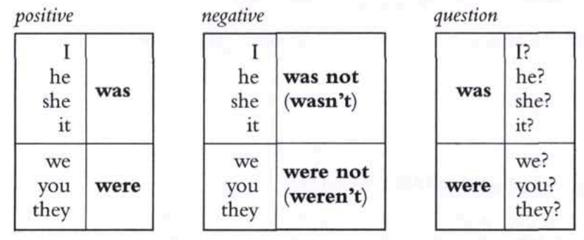
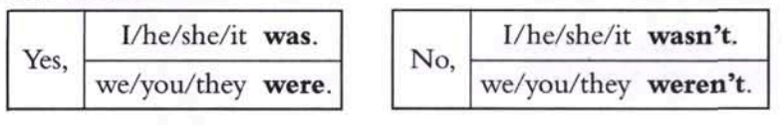
the simple past tense (be)
short answers

Slide 18
2. 含有行为动词的一般过去时的各种句式
肯定句：主语+ 动词过去式+其他。
Nancy grew some flowers last year.
南希去年种了一些花。
否定句：主语+didn't + 动词原形+其他。
He didn’t see anything at that time.
当时他什么也没有看见。
行为动词过去式的否定形式要加助动词didn’t，原谓语动词变回原形，didn’t没有人称和数的变化。

Slide 19
一般疑问句及回答：
—Did +主语 + 动词原形 +其他？
—Yes, 主语 + did./No, 主语 + didn't .
(1) — Did you go to visit your grandparents
last Sunday?
— Yes, I did./No, I didn’t.
(2) —Did you phone Jim yesterday?
—Yes, I did./ No, I didn’t.
(3) —Did he visit his aunt last weekend?
—Yes, he did. /No, he didn’t.

Slide 20
特殊疑问句及回答：
— 疑问词+did+主语+动词原形+其他?
— 主语+动词过去式+其他.
— What did she say after hearing the
bad news?
听到这个坏消息后她说什么了？
— She said nothing at that time.
当时她什么都没说。

Slide 21
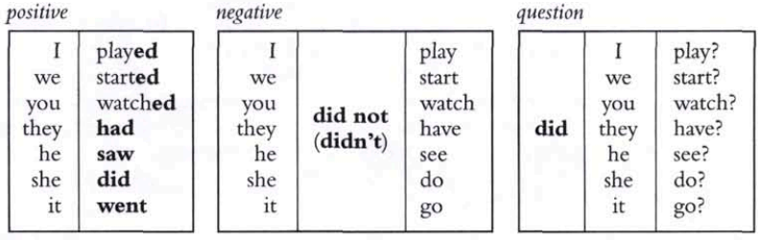

the simple past tense (do)
short answers

Slide 22
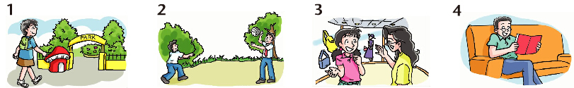
do go have play practise read stay visit
A
Millie is writing about what she and her friends did last weekend. Help her complete her article with the correct forms of the verbs in the box. (P 74)
Yesterday was Sunday. I ______ the park and ____ a good time. Simon did not ____ football. He ________ playing volleyball with his friend. Kitty likes shopping. She ___ some shopping with her mum yesterday afternoon. Daniel did not ___ out yesterday. He ______ at home and _____ some books.
visited
had
play
practised
did
go
stayed
read

Slide 23
Did go
Sandy: ___ you and your family ___ (go)
camping last week?
Simon: No, we ______. We _____ (go)
camping last month.
Sandy: ____ (be) it interesting?
Simon: Yes, it ____.
didn’t
went
B
Sandy is asking Simon about his camping trip with his family. Complete their conversation with the correct forms of the verbs in brackets. (P 74)
Was
was
Sandy: What ___ you ___ (do) there?
Simon: We ____ (put) up our tent near a
lake. My cousin Annie and I ____
(be) very happy. We also _____
(row) a boat on the lake.
Sandy: ____ you ____ (stay) outside all
night?
Simon: Yes, we ____. The camping trip
____ (be) really wonderful.
did do
put
were
rowed
Did stay
did
was

Slide 24


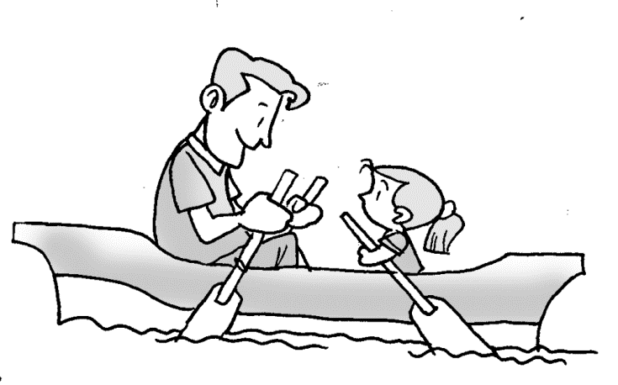
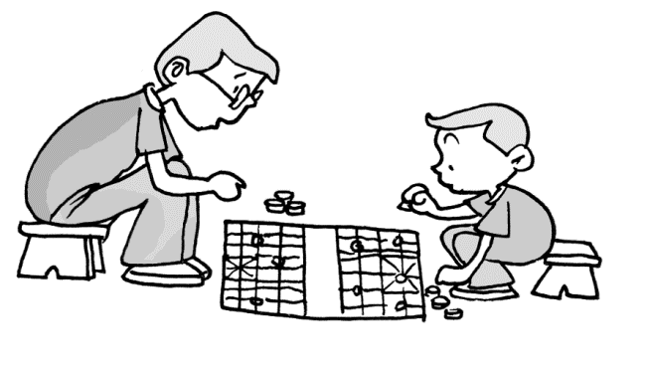

Think of things you did last weekend. Draw pictures of them. Your classmates guess what you did.
went to the mountains
went boating
played chess
A: What did I do last week?
B: You went to the mountains.
A: What did I do last week?
B: You …

Slide 25
巧记动词过去时态
动词一般过去时，表示过去发生事；
be用was或用were, have, has变had；
谓语动词过去式，过去时间做标志；
一般动词加-ed，若是特殊得硬记。
否定句很简单，主语之后didn’t添；
疑问句也不难，did放在主语前；
谓语之前有did，谓语动词需还原；
动词若是was, were，否定就把not添。

Slide 26
Summary
由be动词构成的一般过去时
肯定句 | 主语+was/were+其他.
否定句 | 主语+wasn’t/weren’t+其他.
一般疑问句 | Was/Were+主语+其他?
答语 | 肯定：Yes, 主语(代词)+was/were. 否定：No, 主语(代 词)+wasn’t/weren’t.
特殊疑问句 | 疑问词+was/were+主语+其他?

Slide 27
由行为动词构成的一般过去时
肯定句 | 主语+行为动词过去式+其他.
否定句 | 主语+did not (didn’t)+动词原形+其他.
一般疑问句 | Did+主语+动词原形+其他?
答语 | 肯定：Yes, 主语+did. 否定：No, 主语+didn’t.
特殊疑问句 | 疑问词+did+主语+动词原形+其他?

Slide 28




Slide 29
Ⅰ. 改错。将正确的句子写在横线上。
1. Tom said the children aren’t in the garden at that time.
________________________________________
2. Do you study for a test at home last Saturday?
________________________________________
3. Bob uses my computer when I was out today.
________________________________________
4. My sister doesn’t wear her new dress yesterday.
_________________________________________
5. Who do you went to Beijing with last summer?
_________________________________________
weren’t
Did
used
didn’t
did
go

Slide 30

Ⅱ. 单项选择。
1. — Where did you go last weekend?
— I _____ to the Great Wall.
A. go B. went C. will go D. am going
2. ______the weather warm in Shanghai yesterday?
A. Is B. Were C. Was D. Did
3. — Why are you late for class again, Alan?
— I’m sorry, Mr Hu. I ______ the first bus this morning.
A. won’t catch B. don’t catch
C. didn’t catch D. am catching

Slide 31
4. — When ____ Mr Smith____ for London?
— Yesterday afternoon.
A. does; leave B. did; leave
C. is; leaving D. do; leave
5. — Oh no, I can’t find my mobile phone.
— Well, where ____ you last put it?
A. have B. do C. did D. does
6. — Tom, it’s dangerous to swim here.Look at the sign!
— Oh, I ___ it. Thank you.
A. didn’t notice B. won’t notice
C. don’t notice D. doesn’t notice

Slide 32
Was
Jane: (1)_____(be) Eric late for school this morning?
Ben: Yes. He (2)_____ (see) an old man fall on the street and (3)_____ (help) send him to the hospital.
Jane: Really? Eric (4)_____ (be) a kind boy.
Ben: Yes. Last time he (5) _____ (pick) up a wallet on the way home. He (6)______________(not bring) it home, but (7)_______ (wait) for the owner for two hours.
Jane: (8)_____ the owner_____ (come) at last?
Ben: Yes. He (9)_____ (want) to give Eric some money, but Eric (10)__________ (not take) it.
Jane: Oh, I remember. Later the owner(11)_____ (write) a thank-you letter to our school.
Ben: Yes. Eric is also very helpful. He often(12)_____ (clean) the house and (13)_____(shop) for the old people in his neighbourhood.
Jane: Why don’t we recommend (推荐) Eric for this year’s best student then?
Ben: Good idea!
Ⅲ. 根据对话内容，用括号内词的适当形式填空，补全对话。
saw
helped
is
picked
didn’t bring
waited
Did
come
wanted
didn’t take
wrote
cleans
shops

Slide 33

1. Review the grammar we’ve learned today.
2. Finish the exercises in Learning English.
3. Preview Integrated skills on pages 75-76.

